Slide 1
Context Clue

Slide 2
Context Clues
Words and sentences around other words that help the reader figure out the meaning of an unknown word or phrase.
Types of context clues
Definition
Example/Illustrations
Root words and affixes
Contrast
Logic

Slide 3
Definition
A writer may directly define a word for the reader.
Many people enjoy the crescendo, a gradual increase of volume, of a popular piece of music.

Slide 4
Example / Illustration
The writer will provide an example or examples to illustrate a word or sentence.
Dodos, wooly mammoths, and dinosaurs are examples of extinct animals.

Slide 5
Compare / Contrast
A writer will compare or contrast a word with another word to show the meaning.
The female praying mantis will decapitate its mate after mating, while the male grasshopper may simply die after hours of days of mating with the female grasshopper.

Slide 6
Root Words and Affixes
Readers depend on their knowledge of root words and affixes to figure out the meaning of a word.
Also referred to as WORD STEMS.
Yolanda found several antebellum heirlooms in the closet.
Ante – before
Bell - war

Slide 7
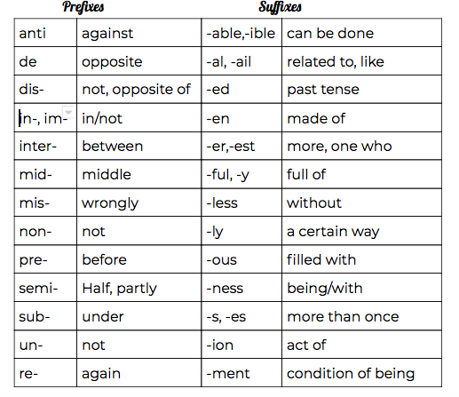
Word Stems

Slide 8
A word stem means breaking down the word to figure out its meaning.
REEVALUATING
You will look at the prefix, suffix and root word to determine meaning.
RE/EVALUATE/ING
Re- means to do something again
Evaluate means to look over/study something
-Ing expresses action, so it is happening right now.
EXAMPLE: Mrs. Skinner is reevaluating the semester exam before December.

Slide 9
Logic
The reader considers the entire sentence to discover the meaning of the unknown words.
The soldiers refused to capitulate to the enemy and stood their ground in the fight.
Capitulate must mean to not give up if the soldiers stood their ground.

Slide 10
Once you have completed the guided notes/worksheet from yesterday…
Create your own 4 word stems from the list below.
1. Break down the word by syllable.
2. Tell me what the prefix means, the suffix, and the root word.
3. Use the word in a sentence.
Interwoven Ultraviolent
Miscommunication Omnipresent
Unawareness Atypical
Mishap Prohibited
Hyperactivity Proceeded
*** I will give you extra credit points if you draw a picture demonstrating two of your sentences.

